Slide 1
C++ Primer (Part II)
From C/Java to C++

Slide 2
Part II

Slide 3
Outline
C++ Strings
  The string datatype
  New string operations in C++
Dynamic Memory Allocation
  Stack vs Heap allocation
  The new operator
  The delete operator

Slide 4
Strings
A string is a sequence of characters.
String constants in C++ are enclosed in "".
Examples of string constants:
  "porkpie" (a 7-character string)
  "TVC15" (a 5-character string)
  "A very nice string!" (a 19-character string)

Slide 5
Two Kinds of Strings in C++
In C++, the term string can mean:
  The string data type, which is new to C++. (It did not exist in C.)
    To use it, you must include the <string> header file.
    Also, the namespace of string is “std”, so “using namespace std;” should be included or use the complete name “std::string” instead of simply “string”.
    string str = “My new string”;
  A null-terminated character array. This was the only kind of string in C.
    We will refer to these as C-strings.
    Much less convenient than C++’s string data type, but some people still use it.

Slide 6
Using [] with the string Type
You can use the operator [] (array subscript operator) to access an individual character in a string. Example:
string myStr1 = “applepie";
cout << myStr1[1];
  Caution: A string’s first character is in position 0, and its second character is in position 1, and so on.
Declare and initialize a string variable.
Display the character in position 1 of the string.
Notes:
-Do practice question 1.

Slide 7
Input a C++ string
We can simply input a string using cin.
  cin >> myStr1;
String input using cin is truncated by whitespace characters.
  Inputting “my string” will strore only “my” in myStr1.
We must use the function getline function to read in a string containing whiespaces.
  getline(cin,myStr1);

Slide 8
Input a C-style string
Declare a C-style string.
  Char myStrC1[50] = “default”;
For strings containing no whitespace characters, input can be performed using cin.
  cin>>myStrC1;
For strings containing no whitespace characters, input can be performed using:
  gets(myStrC1); // need to include stdio.h
  cin.getline(myStrC1, 20); // 2nd parameter is maximum number of characters to input. Note that the use of getline is different from inputting a C++ String.

Slide 9
Using + with the string Type
The binary operator + concatenates (combines) strings to create a longer string.
Example:
string myStr1, myStr2, myStr3;
myStr1 = “applepie";
myStr2 = "hat";
myStr3 = "my " + myStr1 + " " + myStr2;
cout << myStr3; // will display “my applepie hat”
Notes:
-Do as practice question 2.
-Then single-step week08String.cpp.

Slide 10
Lots of string Functions
The <string> header file contains many useful and powerful functions for working with strings.
  Some of these are listed in Table on next slides.
    Note that some of these functions (which are marked with *) update the string on which they operate. Also, some functions (which are marked with red arrows) are equivalent to each other.

Slide 11
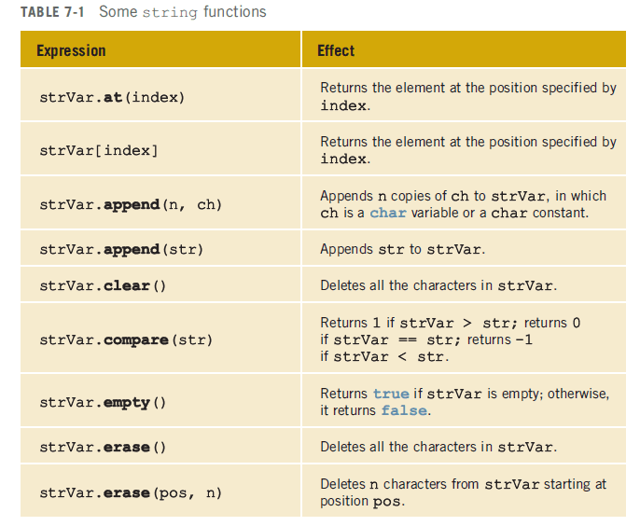
*
*
*
*
*
Notes:
-Note that append and erase are overloaded functions.
-Do practice question 3.

Slide 12
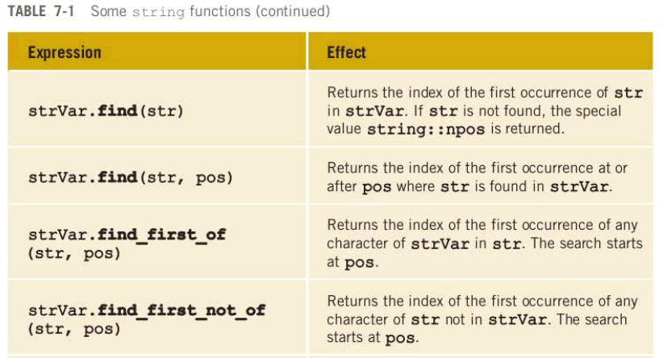
This “special value” is equal to -1.
Notes:
-Do practice question 4.

Slide 13
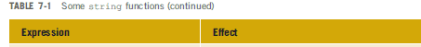
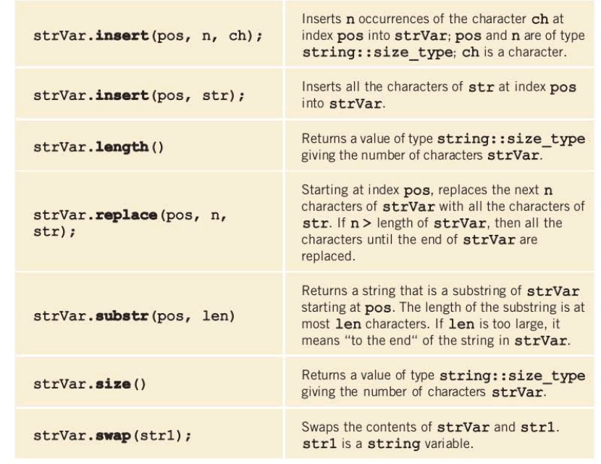
*
*
*
*
Notes:
-Do practice question 5.

Slide 14
Dynamically Memory Allocation (DMA)

Slide 15
Allocation Memory
Compile time (or static) allocation
  Memory for the named variables is allocated by the compiler on a memory area called stack.
  The exact size and type of storage must be known.
  The array size has to be constant.
Dynamic memory allocation
  Memory allocated during run time, placed in a program segment known as the heap or the freestore.
  The compiler does not need to know the exact size and number of items to be allocated.
  Pointers are crucial.

Slide 16
Dynamic Memory Allocation (DMA)
There are two steps in dynamic allocation
  Allocate the space
  Store its address in a pointer (so that the space can be accessed)
Use the new operator

Slide 17
Deallocation
Free up the allocated space
Compile time (automatic) variables are automatically deallocated, as they go out of scope permanently.
However, freeing dynamically allocated memory is the responsibility of the programmer.
  If the variable (pointer) created using DMA is no longer usable, then the programmer should free this memory using the delete operator.
Not freeing/deleting the dynamically allocated memory will result in wastage of memory (i.e. memory is still allocated, but cannot be used by the program).

Slide 18
Allocating Space with new
To allocate space dynamically, use the unary operator new, followed by the type being allocated
  new int; // allocate memory for an integer
  new double;
  new int[40]; // dynamically allocates an array of 40 ints
  new double[n]; // dynamically allocates an array of n
  // doubles, where n can be a variable.

Slide 19
Allocating Space with new
new by itself allocates spaces with no names.
  DMA creates memory, but does not create new variable names at runtime.
new returns the starting address of the allocated space, which can be stored in a pointer.
  Remember, pointers store address, normal variables don’t.
  int *p = new int; // 1234 // declares a pointer p
  *p = 50;
  int x = 40;
  int *list = new int[x];
  float *numbers = new float[x + 10];

Slide 20
Accessing Dynamically Allocated Space
For single items, dereference the pointer to reach dynamically created target
  int *p = new int;
  *p = 10; // assigns 10 to the dynamic integer
  cout << *p; // prints 10
For dynamically created arrays, you can use either pointer-offset notation, or standard bracket notation
  double *numList = new double[size];
  for (int i = 0; i < size; i++) numList[i] = 0;
  numList[5] = 20;
  *(numList + 5) = 20; // same as numList[5]

Slide 21
Deallocation of Dynamic Memory
Use unary operator delete
  int *ptr = new int;
  delete ptr; // free up the space pointed by ptr
Note that the name ptr can be reused
  ptr = new int[10];

Slide 22
Deallocation of Dynamic Memory
To deallocate a dynamic array, use this form
  delete [] name_of_pointer;
Example
  int *list = new int[40];
  delete [] list; // deallocates the array
  list = NULL; // reset the pointer to null
We don’t want list pointer to point to deallocated space.

Slide 23
Allocation Static/dynamic Arrays
Stack allocation
int intArray[10];
intArray[0] = 6837;
Heap allocation
int *intArray;
intArray = new int[10];
intArray[0] = 6837;
...
delete[] intArray;
Notes:
C++ arrays are zero-indexed.

Slide 24
Memory Leakage
Suppose, You fail to deallocate dynamically allocated memory…
list = new int[40]; // first allocation
…// no deallocation…
list = new int[10]; // second allocation
Result…
  Memory leak…
    Memory allocated in First allocation is still occupied, but cannot be used in the program, because there is no way (i.e. no variable) to access this memory now.

Slide 25
Example
class Fraction {
public:
int num;
int den;
public:
Fraction(int top, int bottom) {
num = top;
den = bottom;
}
Fraction() {
Fraction(0,0);
}
};

Slide 26
Dynamic Allocation of Objects
Objects can be dynamically allocated as well
  Fraction f1(3,5);
  Fraction *fp1, *fp2, *flist;
  fp1 = new Fraction; // uses default contructor
  fp2 = new Fraction(3,4);
  cout<<fp2->num;
  flist = new Fraction[20]; // dynamic array of 20 Fraction // objects with default constructor used for each
  flist[19]->den
To deallocate
  delete fp1; delete fp2; delete [] flist;

Slide 27
Dynamically Resizing an Array
Suppose you want to grow an array
  int *list = new int[size]; // size =10
  // process list until the number of elements exceed ‘size’
  int *temp = new int[size + 5]; // create a bigger temp array
  for (int i = 0; i < size; i++)
  temp[i] = list[i]; // copy the data
  delete [] list; // free up the old memory location
  list = temp; // make list point to the new memory location
  fun(list);
  Void fun(int *List2)
  {
  List2[0] = 20;
  }

